Slide 1
Government and Laws
Chapter 6

Slide 2
Role of Regulators
Protecting Consumers:
  Most laws are designed to protect the safety, health, and welfare of individual
  Occupational licensing
    Hairstylists, electricians, accountants, home inspector, pharmacist
  Health Department
    Inspection of restaurants, daycare centers, sanitation

Slide 3
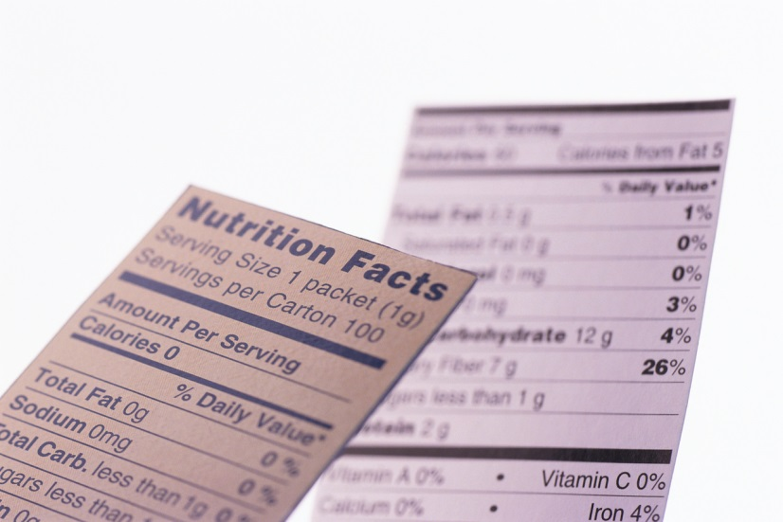
Federal Agencies:
Protecting Consumers
Food and Drug Administration (FDA)
  Regulates the labeling and safety of food, drugs, and cosmetics sold in the US
  Approves new products
  Reviews existing products
    Banned dietary supplement, ephedra in 2004
  Guidance in definitions
    Food labeling, low-carb, low fat, organic
Notes:
Adverse effects of ephedra consumption may include severe skin reactions, irritability, nervousness, dizziness, trembling, headache, insomnia, profuse perspiration, dehydration, itchy scalp and skin, vomiting, and hyperthermia. More serious potential side effects include irregular heartbeat, seizures, heart attack, stroke, and death. Used toward making meth. Also banned as a performance enhancing drug in sports.

Slide 4

Federal Agencies:
Protecting Consumers
Consumer Product Safety Commission (CPSC)
  Responsible for overseeing the safety of products
    Electronics, toys and household furniture
      NOT food, drugs, cosmetics, medical devices, tobacco, firearms, motor vehicles, pesticides, aircraft, boats, amusement rides
  Sets standards for products and recall dangerous products
    Businesses need to pay particular
    attention to safety, labeling,
    directions for safe use
Notes:
http://www.lovelandmagazine.com/2007/06/thomas-the-tank.html

Slide 5
Federal Agencies:
Protecting Workers
Equal Employment Opportunity Commission (EEOC)
  Responsible for the fair and equitable treatment of employees
    Hiring, firing, and promotions
      Enforces Title VII of the Civil Rights Act, Equal Pay Act, Age Discrimination in Employment Act, Title I and V of the Americans with Disabilities Act, and Civil Rights Act
Family and Medical Leave Act (FMLA)
  Requires employers that qualify to grant eligible employees up to a total of 12 workweeks of unpaid leave during a 12 month period

Slide 6

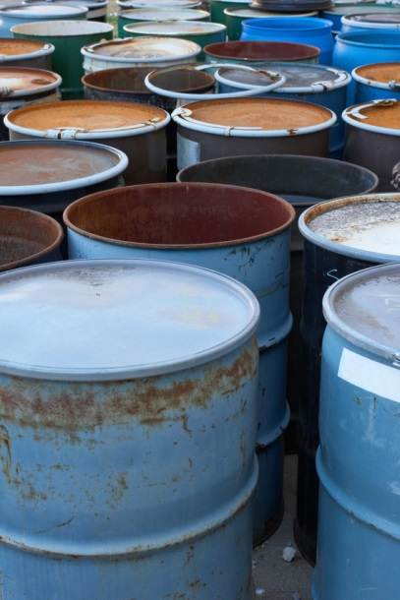
Federal Agencies:
Protecting Workers
Occupational Safety and Health Administration (OSHA)
  Provides guidelines for workplace safety and enforces those regulations
    Hard hats, reflectors, disposals, hazards training

Slide 7

Federal Agencies:
Protecting Investors
Security and Exchange Commission (SEC)
  Regulates the sale of securities (stocks and bonds)
  Responsible for licensing brokerage firms and financial advisors
  Investigates mergers and acquisitions (where it may affect stock)
  Requires honest reporting

Slide 8
Social Responsibility and Business Ethics

Slide 9

Federal Agencies:
Protecting the Environment
Environmental Protection Agency (EPA)
  Protect human health and our environment
  Responsibilities include monitoring and reducing air and water pollution, as well as hazardous waste disposal and recycling
    Pollution controls: diesel engines
    Acid rain, asbestos, lead poisoning, mercury, mold, ozone depletion, pesticides, radon
    Advertising practices: no longer allowed to place advertising leaflets on vehicles

Slide 10
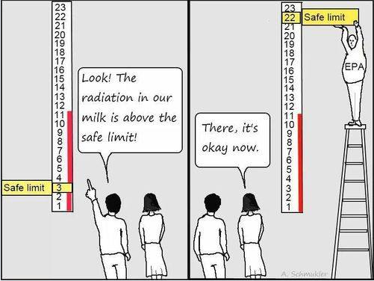

Slide 11
Social Responsibility
Social Responsibility
  The idea that companies should embrace its social responsibilities and not be solely focused on maximizing profits. Social responsibility entails developing businesses with a positive relationship to the society which they operate in
Notes:
Defining Social Responsibility - Investopedia

Slide 12
Social Responsibility
Social Responsibility
  In the Workplace
    Employees needs: flextime, telecommuting, family leave, on-site childcare, health care benefits, paid time off
  In the Marketplace
    Information reporting, employing self-censorship (avoiding controversy and keeping appropriateness)
    Responding to consumer concerns (obesity)
  In the Community
    Support community efforts (funds, food drive, Toys for Tots)
    Donate proceeds
    Leaders in eco-efficiency, innovation
  In the Environment
    Cleaner fuel
    Green Marketing: companies make an effort to produce and promote environmentally safe products

Slide 13

Business Ethics
A major aspect of social responsibility
Ethics
  Guidelines for good behavior
    Based on knowing the difference between right and wrong AND doing what is right
    Takes into account the well-being of everyone

Slide 14
Ethics in Consumerism
Consumerism
  The societal effort to protect consumer rights by putting legal, moral, and economic pressure on business
    Shared effort by everyone
Consumers have 4 basic rights:
To be informed and protected against fraud, deceit, and misleading statements
To be protected from unsafe products
To have a choice of goods and services
To have a voice in product and marketing decisions made by government and business

Slide 15


Ethics in Marketing
Self-regulation
  Being Proactive
  Better Business Bureau (BBB)
    Agree to follow the highest principles of business ethics and have a proven record of honesty
  AMA Code of Ethics
    “not knowingly do harm”
    Includes “all relevant publics: customers, organizations, and society”
    “products and services offered are safe and fit for their intended uses”
    “disclosure of all substantial risks associated with product or service usage”

Slide 16
Ethics in Marketing
Ethical Issues Related to Marketing Functions
  Price Gouging – pricing products unreasonably high when the need is great or when consumers do not have other choices
    During times of catastrophe
    Some exclusions – pharmaceuticals
  Management of marketing information
    Privacy – Security over customer databases
    Product and marketing research must report their findings honestly by disclosing all the facts involved
  Selling practices
    Bribes, kickbacks, favors, and high-pressure tactics used to close a sale - Cultural differences complicate

Slide 17
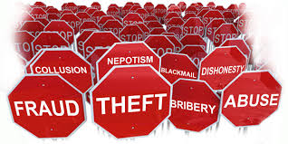
Managerial and Personnel Issues
Proper Accounting and Reporting
  Sarbanes-Oxley Act of 2002
    Reporting of a corporation’s financial situation are addressed and executives and consulting firms can be held accountable for misinformation
  Whistle-Blowing
    Involves reporting an illegal action of one’s employer
      Personal ethics
      Companies must have a policy in place for reporting

Slide 18
Guidelines for Ethical Behavior
Companies should have guidelines to help employees make ethical decisions
  Decisions can be based on personal ethics rather than business guidelines and policies
To make the right ethical choices, employees at all levels should follow a decision making process that includes the following:
Get the facts
Identify all parties concerned
Think of all your alternatives
Evaluate your alternatives by asking yourself the following questions:
  Is it in compliance with the law?
  Does it go against company policy?
  How does it affect everyone involved?
  Is it right, fair, and honest?
  Will it build good will for the company?
  Am I comfortable with it?
  How will it hold up to public scrutiny?

Slide 19
Quick Review
Name 6 employee benefits that demonstrate social responsibility in the workplace
What can business do in the marketplace to demonstrate social responsibility?
Notes:
In the Workplace
Employees needs: flextime, telecommuting, family leave, on-site childcare, health care benefits, paid time off
In the Marketplace
Information reporting, employing self-censorship (avoiding controversy and keeping appropriateness)
Responding to consumer concerns (obesity)

